Slide 1
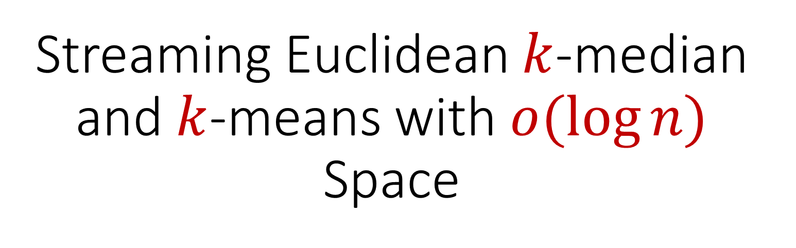
Streaming Euclidean $k$-median and $k$-means with $o(\log{n)}$ Space

Slide 2

The Streaming Model
Input: Updates to an underlying data set $S$ that arrive sequentially
Output: Evaluation (or approximation) of a given function
Goal: Use space sublinear in the size $n$of the input $S$
1 0 1 1 1 0 0 1

Slide 3
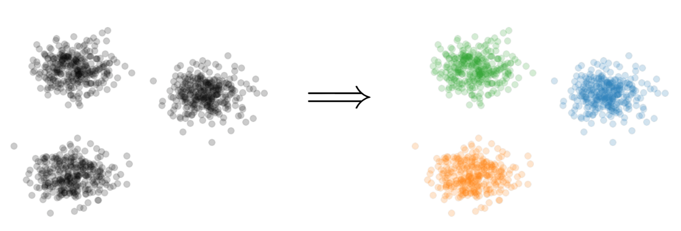


Clustering
Goal: Given dataset $P$, output a set $C$ of $k$ centers to minimize
$$\sum_{p∈P}{Cost(p,C)}$$

